Slide 1


TOURISM TRANSFORMATION SUMMIT
Presentation by
Ms Seja Kekana
NEF Fund Manager
31 October 2017

Slide 2
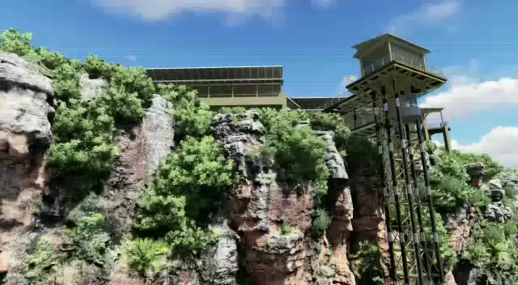
Tourism Highlight – Graskop Lift Company
Video animation here

Slide 3
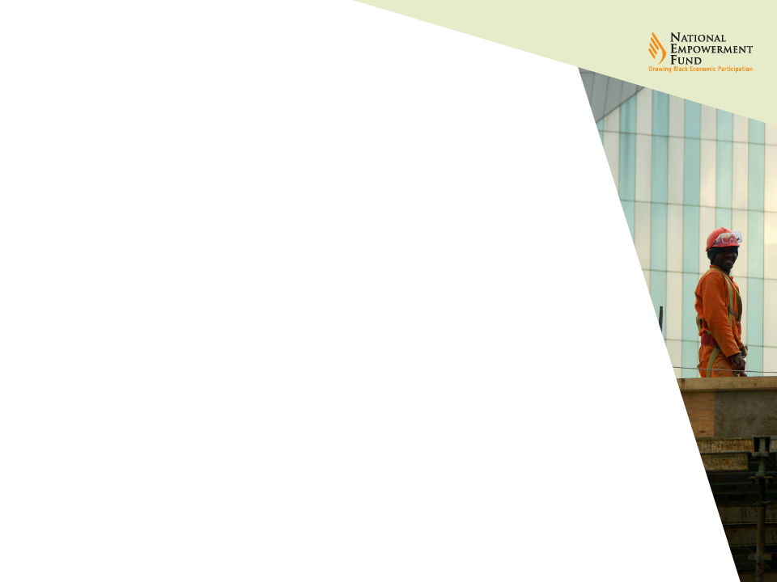
Project Milestones Prior to NEF
The regional local economic development agency issued a RFI to seek ideas for igniting economic activity in the Graskop Gorge along the Panorama route;
Post RFI adjudication, a follow-up RFP was issued;
With Public Private Partnership (PPP) principles adopted – a suitable project was identified and awarded;
A project Pre-feasibility Study was concluded in partnership with the regional agency and the municipality;
Project site was prepared and handed over to the project;
Project raised capital through the assistance of the NEF’s Mpumalanga regional office located in Nelspruit.

Slide 4

Assistance Provided by the NEF
Approval of R33.4mil towards conclusion of a Bankable Feasibility Study (BFS) and Financial Close (Implementation of the project);
Appointment of all Technical Project Team members (e.g. Architect, Engineers, Project Manager etc.) and conclusion of SLAs with all members;
Conclusion of Key Technical Assessments i.e. Geotechnical studies, topographical surveys, EIA, Project Designs etc.
Confirmation of water & sanitation services, electricity supply and approval of all plans obtained from the relevant district municipality;
Issuing and adjudication of construction tender and award to a black-owned company;
Social consultation and investor education of the affected communities;
Construction has commenced and it is at 70% Completion;
Project set to meet the Commercial Operations Start Date of the 4th December 2017.
Project is to create 145 direct jobs and ca.150 jobs during the construction
4

Slide 5
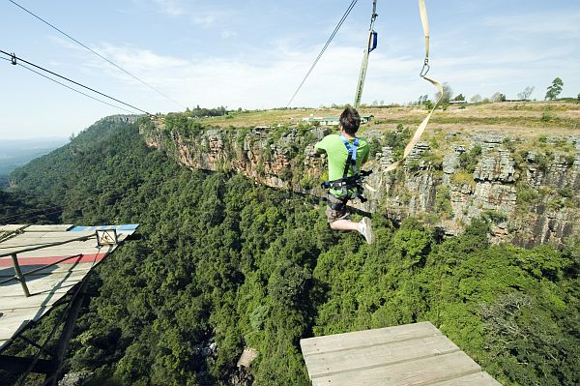
Infrastructure Projects
GRASKOP GORGE LIFT COMPANY: OUTDOOR LIFT SYSTEM
The objective of the project is to develop the Graskop Gorge area into a major tourism node along the Panorama Tourist Route in Mpumalanga. The proposed development is setup in two major phases with developmental goals in each phase to ensure adequate growth and continued sustainability over time. The main feature of the project is the construction of an outdoor lift system that will ferry people up and down off the cliff face into the forest environment below, where various elevated and ground walkways will allow visitors to explore the unique environment. This experience will be enhanced with various information boards and other value added activities such as guided tours etc. Supporting this outdoor lift system will be a newly constructed tourism centre that will provide a multitude of tourism products and services including a restaurant, bar, retail outlets, kids play area and centre management offices that will support the entire development.
Location | Graskop, Mpumalanga
Project Development Stage | Construction
NEF Investment to date | R33.4 million
Project Promoter | Graskop Gorge Lift Company (Pty) Ltd
Total Project Size | R40 million
Jobs | 145 direct

Slide 6

Thank you
Contact Details
 | WHERE | TELEPHONE
1 | Head Office, Johannesburg | 011 305 8000 or 0861843 633 / 0861 THE NEF
2 | Eastern Cape | 0861 633 327 / 0861 NEF ECP
3 | Free State | 0861 633 377 / 0861 NEF FSP
4 | KwaZulu Natal | 0861 633 596 / 0861 NEF KZN
5 | Limpopo | 0861 633 546 / 0861 NEF LIM
6 | Mpumalanga | 0861 633 678 / 0861 NEF MPU
7 | Western Cape | 0861 633 927 / 0861 NEF WCP
8 | North West | 0861 633 697 / 0861 NEF NWP
9 | Northern Cape | 0861 633 627 / 0861 NEF NCP
www.nefcorp.co.za

