Slide 1


Tourism Transformation Summit
Opportunities in Tourism – an overview of SANParks as player in the industry
31 October 2017

Slide 2
Brief Background of SANParks
SANParks - the largest player in eco-tourism industry with 7500 beds (from budget to 5-star) and another 7500 camping beds;
Accounts for 30% of all nature based tourism;
6 million visitors to parks annually;
Mission – to develop, expand, manage and promote a system of sustainable national parks that represents biodiversity and heritage assets, through innovation and best practice for the just and equitable benefit of current and future generations
Notes:
Over the last century SANParks grew into one of the largest players in the tourism industry and THE largest player in the eco-tourism industry with in excess of 7500 beds and 7500 camping beds accounting for 24% of all nature based tourism in SA and receives 5.9 million visitors to the parks per year

Slide 3
Brief Background of SANParks
Manages a system of National Parks
  19 National Parks i.e. Kruger, TMNP, Addo, Kgalagadi etc.
  Over 4 million hectares of land, 9 Biomes i.e. fynbos, nama karoo, savanna etc.
  Core Functions:
Constituency building
Tourism
Conservation

Slide 4
SANParks Market
Visitation Breakdown – Total 6 million
  South African 76.9%;
    Black Visitors 24.94%
  Foreign Visitors 23.1%
    Germany 30.9%
    United Kingdom 9.76%
    France 7.82%
    USA 9.18%
    Netherlands 6.21%
Accommodation Occupancy Rates
  SANParks Accommodation 76.4%
  SANParks Campsites 53.2%

Slide 5
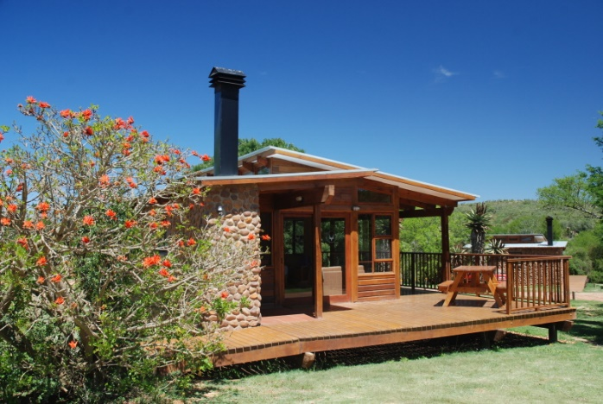
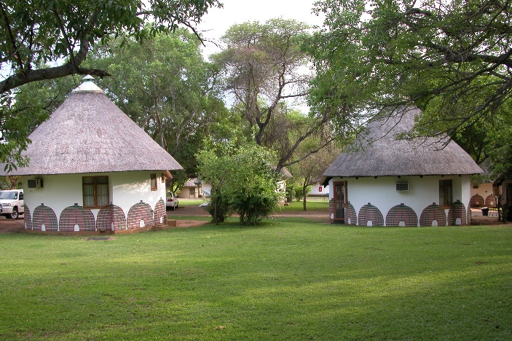
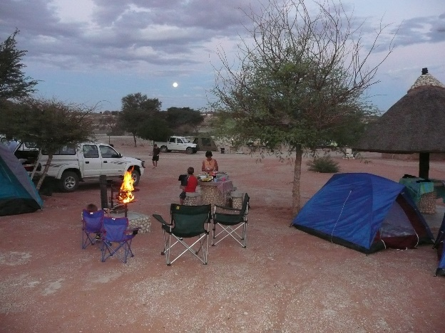
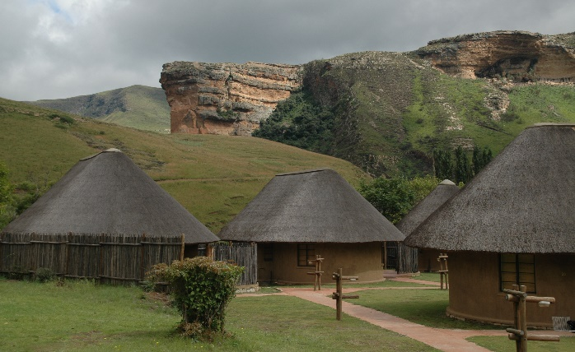
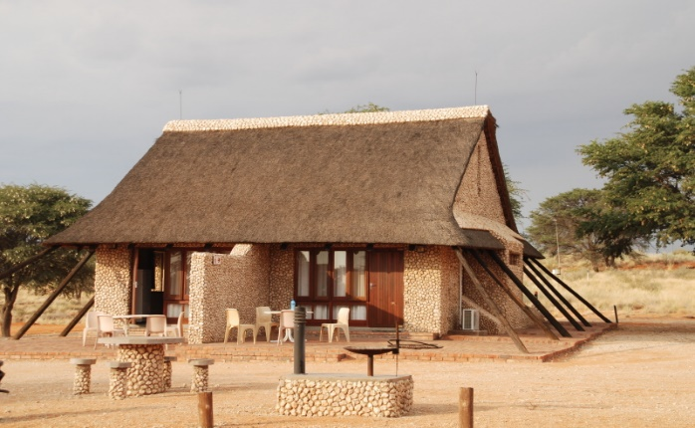
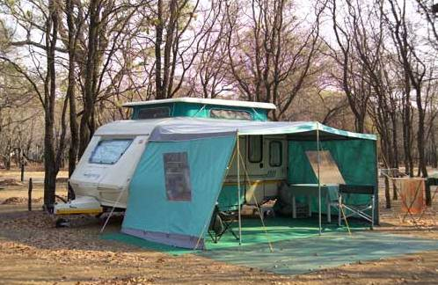
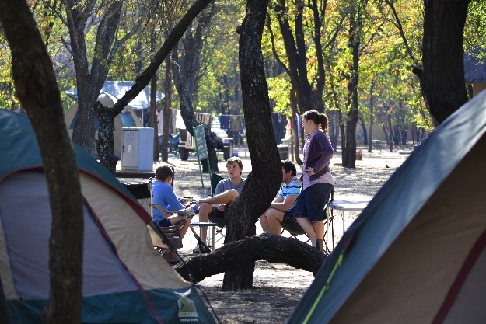
Self-catering in parks
Notes:
SANParks then adopted a strategy whereby selected commercial ventures should be performed by the private sector within an appropriate regulatory frame work to mitigate impacts on biodiversity while ensuring that a risk free return on the conservation assets is leveraged.
This strategy was called Commercialisation as a Conservation Strategy. As the title implies the intention was to:
Increase net revenue that commercial operations contribute to conservation
To transfer specific commercial opportunities to the private sector who are better qualified with access to capital
For SANParks to focus on core business of managing biodiversity in protected areas and provide the framework for the commercial operations to be performed by the private sector
By doing so create opportunities for BEE and SMME development

Slide 6
Self-catering in parks
  Maintenance
  Cleaning
  Building
Notes:
SANParks then adopted a strategy whereby selected commercial ventures should be performed by the private sector within an appropriate regulatory frame work to mitigate impacts on biodiversity while ensuring that a risk free return on the conservation assets is leveraged.
This strategy was called Commercialisation as a Conservation Strategy. As the title implies the intention was to:
Increase net revenue that commercial operations contribute to conservation
To transfer specific commercial opportunities to the private sector who are better qualified with access to capital
For SANParks to focus on core business of managing biodiversity in protected areas and provide the framework for the commercial operations to be performed by the private sector
By doing so create opportunities for BEE and SMME development

Slide 7
Self-catering in parks
  Maintenance
  Pest control
  Cleaning
  Thatching
  Building
  Gardening
Notes:
SANParks then adopted a strategy whereby selected commercial ventures should be performed by the private sector within an appropriate regulatory frame work to mitigate impacts on biodiversity while ensuring that a risk free return on the conservation assets is leveraged.
This strategy was called Commercialisation as a Conservation Strategy. As the title implies the intention was to:
Increase net revenue that commercial operations contribute to conservation
To transfer specific commercial opportunities to the private sector who are better qualified with access to capital
For SANParks to focus on core business of managing biodiversity in protected areas and provide the framework for the commercial operations to be performed by the private sector
By doing so create opportunities for BEE and SMME development

Slide 8
Commercialisation as a Conservation Strategy - Objectives
To increase the net revenue that commercial operations contribute to conservation
To transfer specific commercial opportunities with risk to private sector operators better equipped with access to capital and markets
SANParks to focus on core business of managing biodiversity in protected areas and provide framework for commercial operations
Maximising opportunities for BBBEE and SMME development
Notes:
SANParks then adopted a strategy whereby selected commercial ventures should be performed by the private sector within an appropriate regulatory frame work to mitigate impacts on biodiversity while ensuring that a risk free return on the conservation assets is leveraged.
This strategy was called Commercialisation as a Conservation Strategy. As the title implies the intention was to:
Increase net revenue that commercial operations contribute to conservation
To transfer specific commercial opportunities to the private sector who are better qualified with access to capital
For SANParks to focus on core business of managing biodiversity in protected areas and provide the framework for the commercial operations to be performed by the private sector
By doing so create opportunities for BEE and SMME development

Slide 9
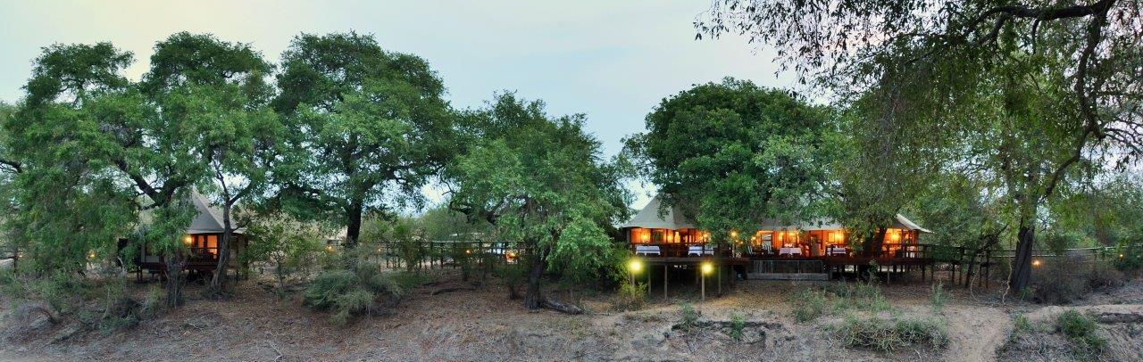

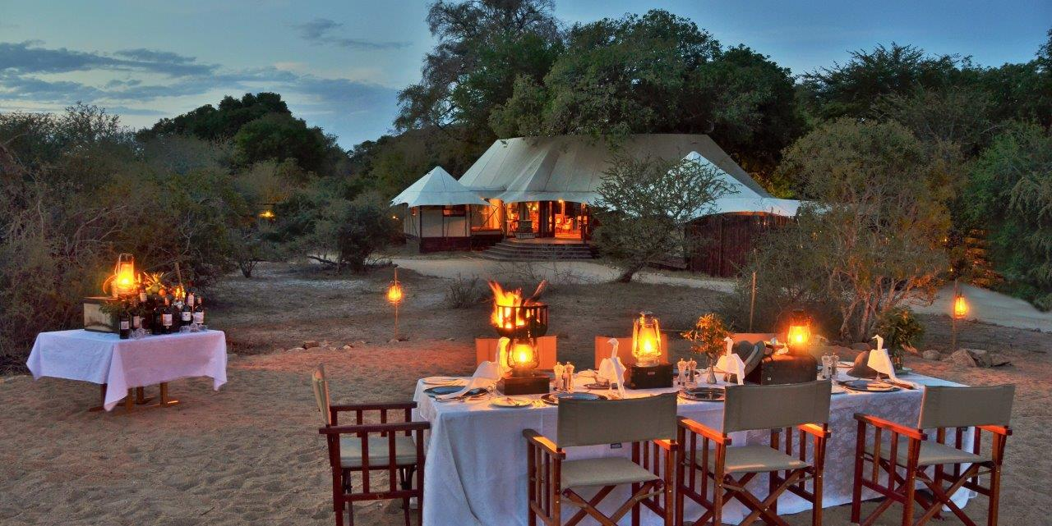
  Black ownership

Slide 10
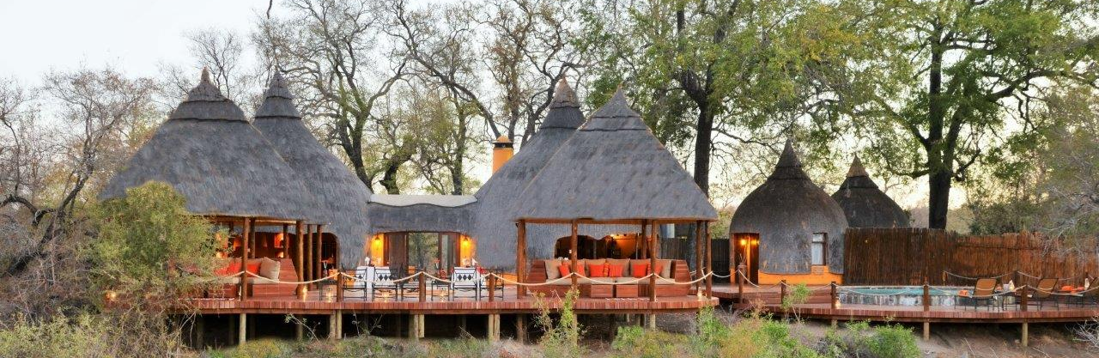

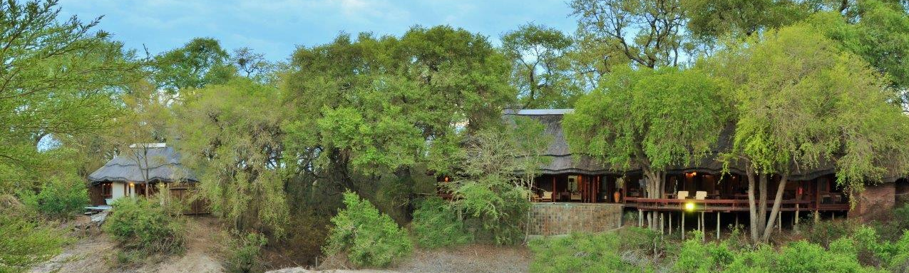

  Black ownership

Slide 11



Slide 12
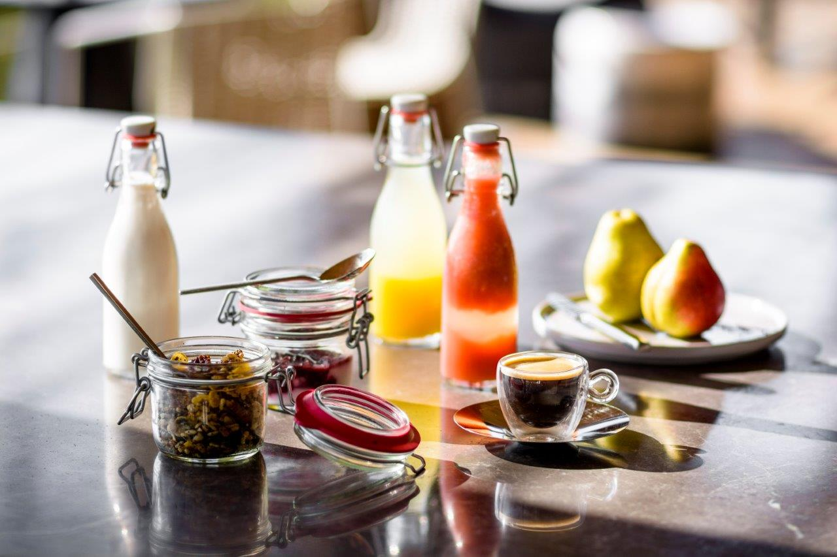
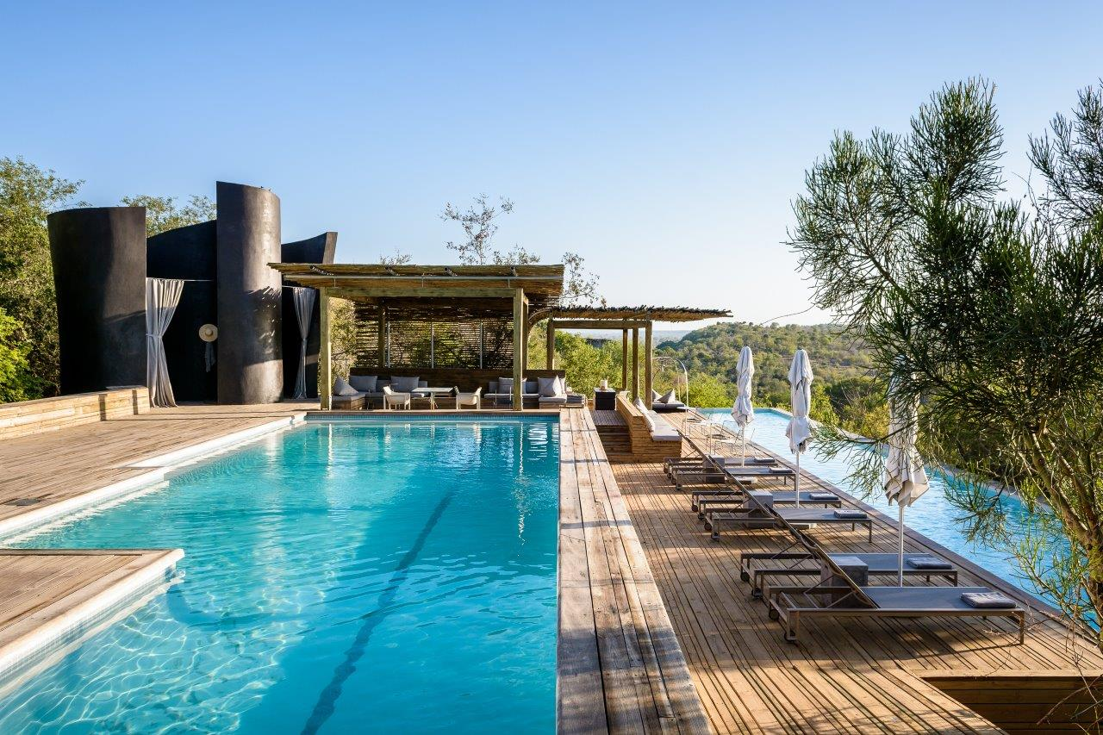
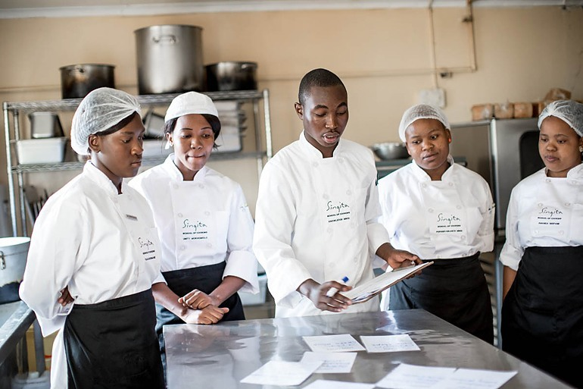
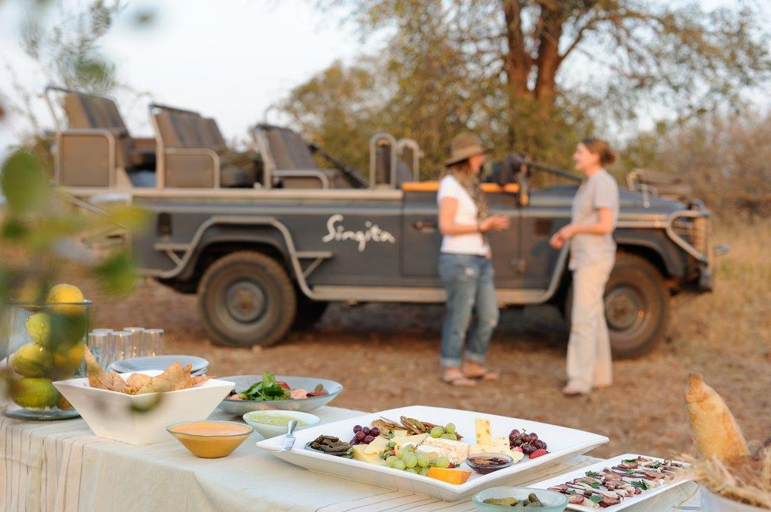
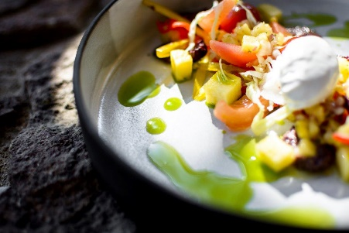
  Cooking school

Slide 13
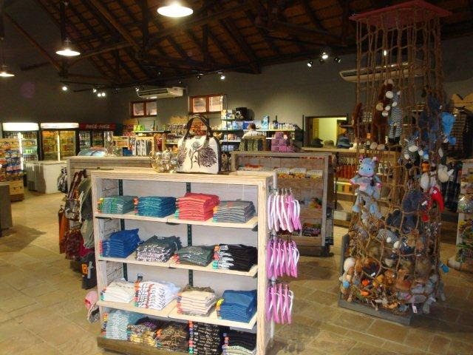
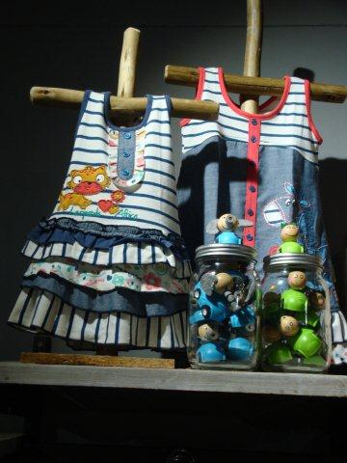
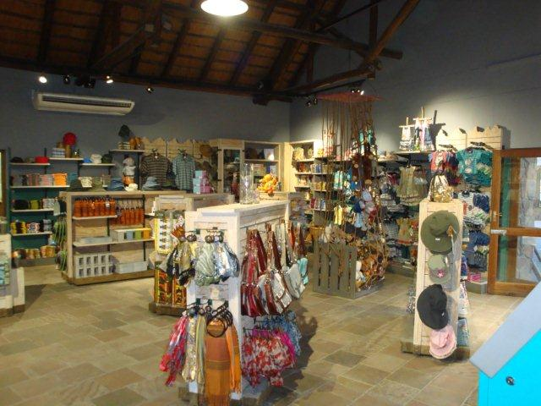
  51% Black ownership

Slide 14
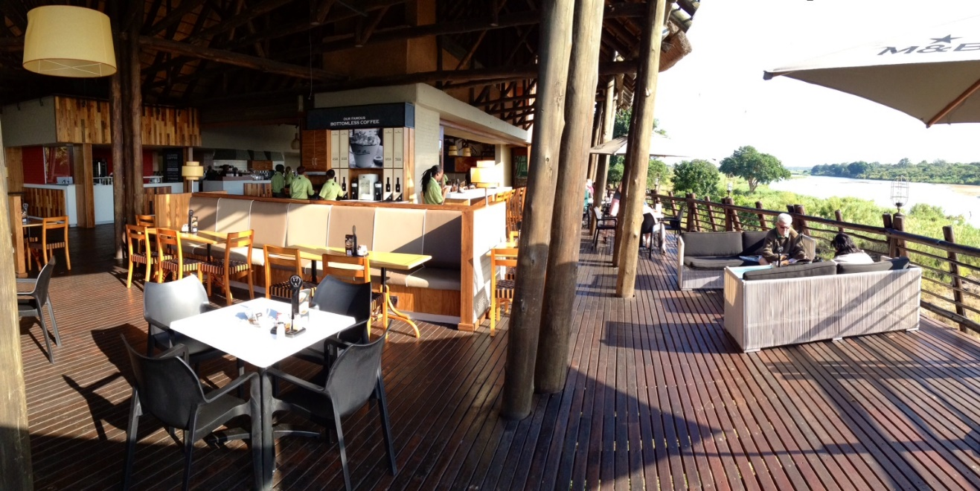

Product Development - Skukuza Airport
Restaurants
  Some franchises 100% black owned

Slide 15
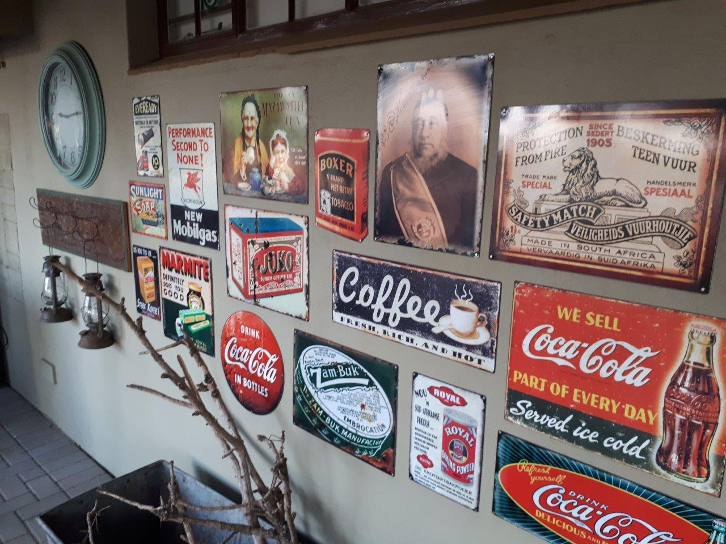
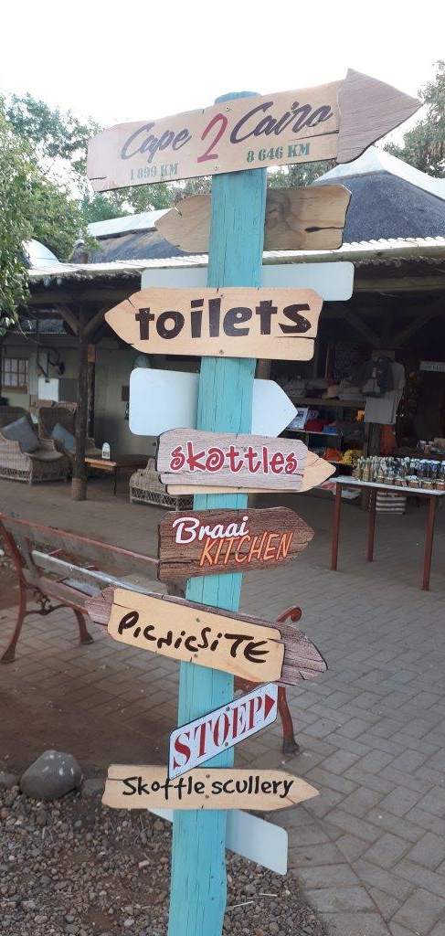

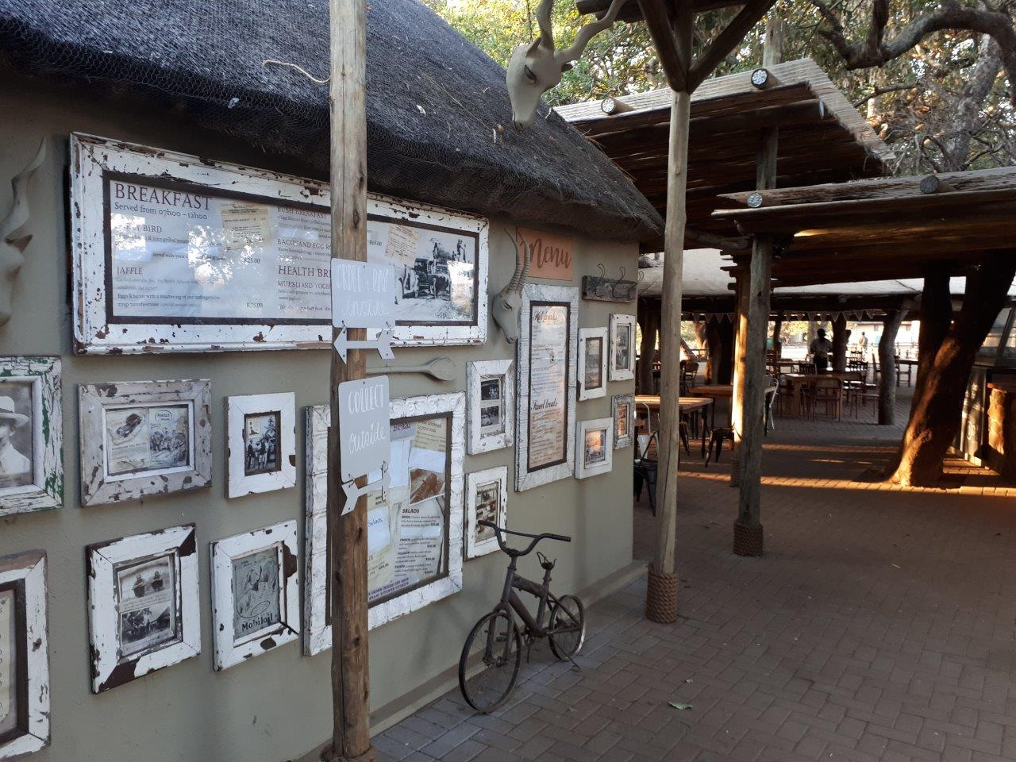
Product Development - Skukuza Airport
  51% Black ownership

Slide 16
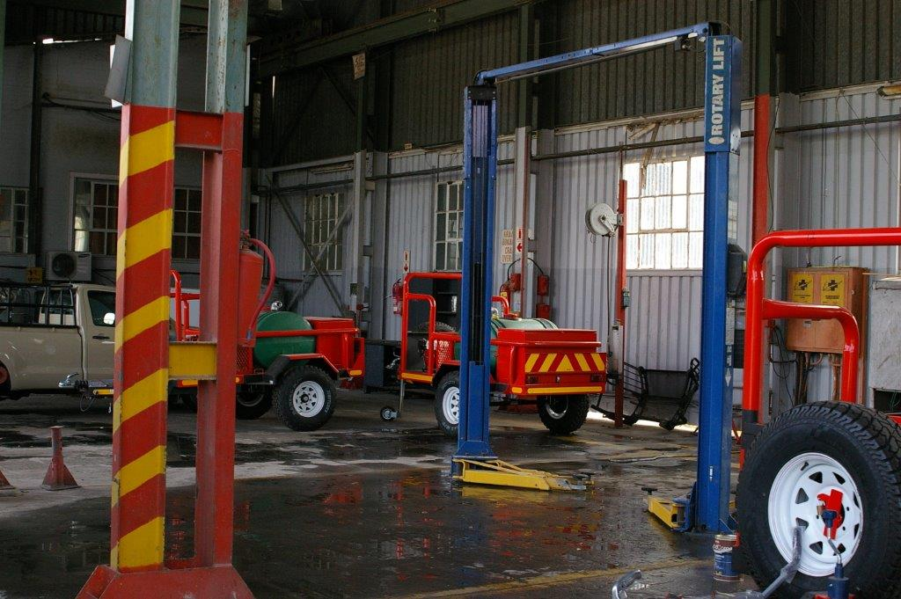

Product Development - Skukuza Airport
  100% Black ownership (women)
Fleet workshops

Slide 17
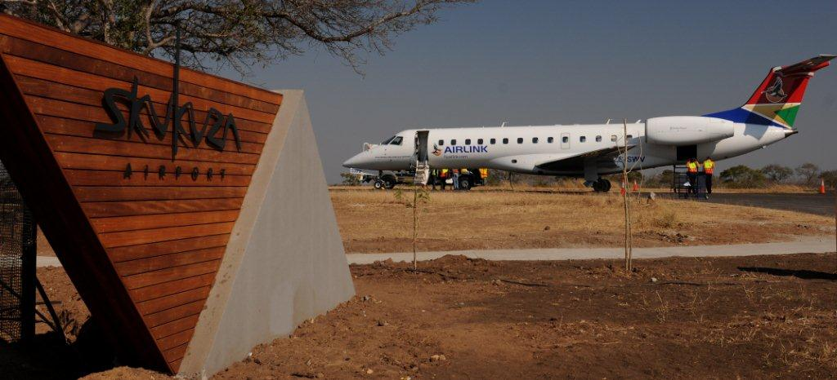
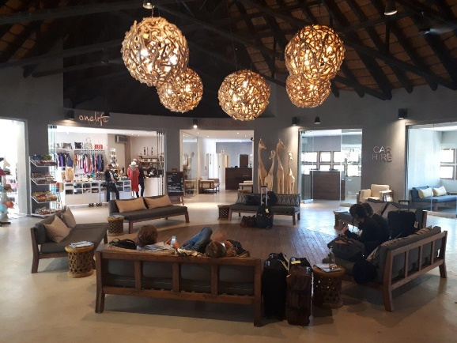
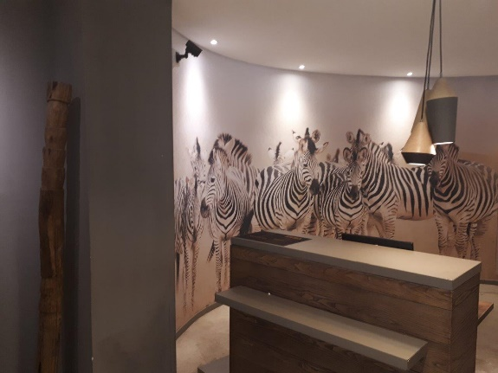
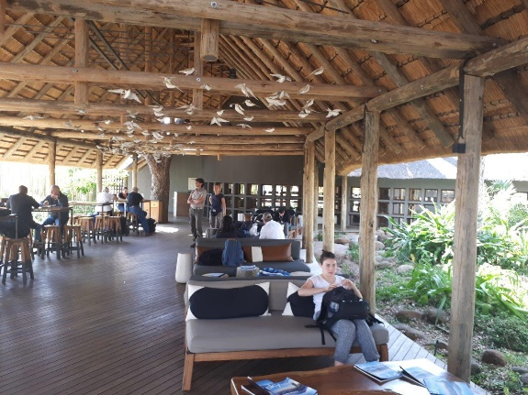
Skukuza Airport
Product Development - Skukuza Airport
  Community ownership

Slide 18

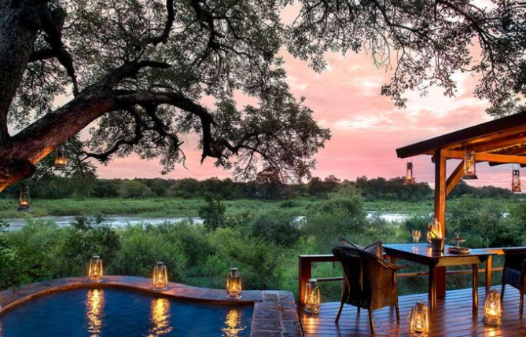

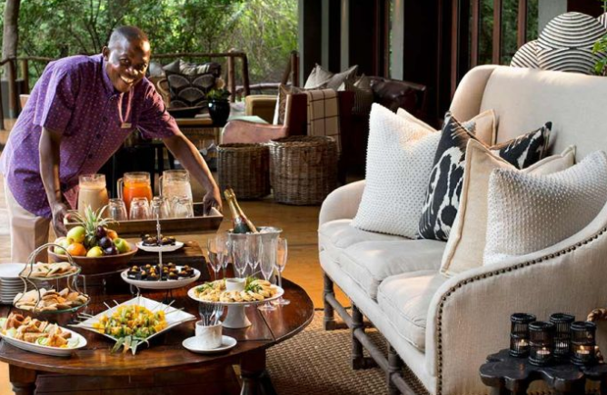
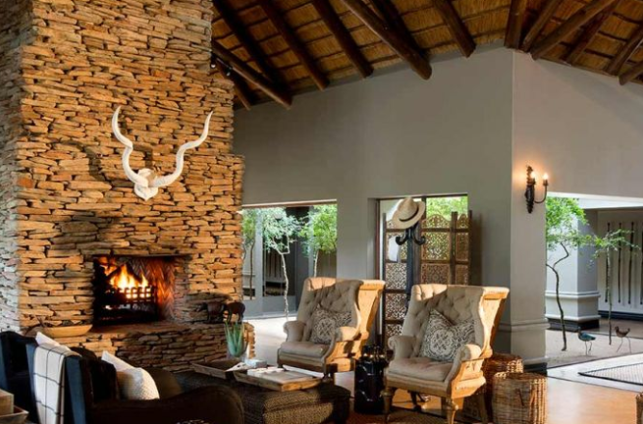
  All other PPP’s:
  At least 65% compliance with Tourism Scorecard

Slide 19
PPP’s Socic-economic benefits
  Increased employment - 2100 additional direct jobs excluding construction;
  79% of employees recruited from communities adjacent to the Parks;
  BEE Equity > BBBEE Tourism Charter and Scorecard;
  SMME spend of R57 million per annum; and
  Multiplier economic effects
Notes:
Benefits of Commercialisation Strategy:
Increased infrastructure of R714 million with assets reverting to SANParks
Product and price differentiation to accommodate different market segments with 380 additional guest beds resulting in foreign exchange generation
Increased employment in tourism industry with1946 new jobs excluding construction

Slide 20
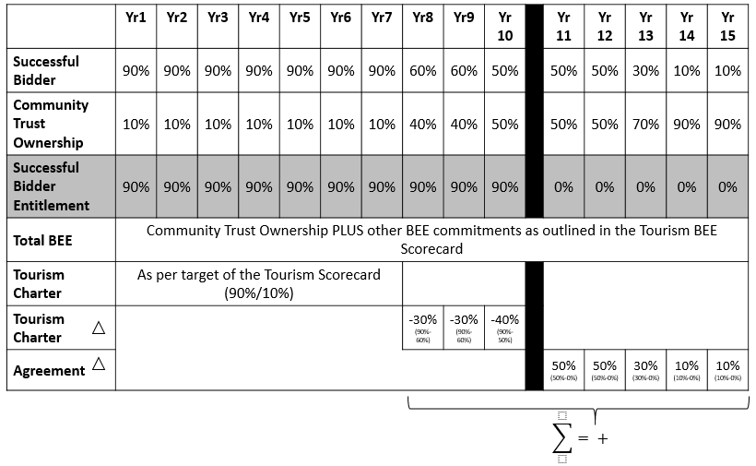
Equity model to transfer ownership to Land Claimants
Notes:
In 1999 SANParks performed an internal review of its operations which reflected that when benchmarked against similar private operations, SANParks had:
Limited market segmentation
Limited product differentiation
Lack of investment in tourism plant
All of which has resulted in a high opportunity cost to biodiversity conservation
In addition:
Since 1994 the SA Government has been accountable to a broader electorate. Government’s limited resources are being reallocated amongst competing needs with a bias towards the more immediate social needs of the electorate. Although Government recognises its responsibility to conservation, funding allocations are based on affordability and conservation is no longer enjoying the levels of financial support it has grown used to.
SANParks, like most other conservation agencies is having to adapt to declining state subsidies. SANParks faces a situation characterized by:
increasing demands from the electorate for meaningful benefits;
Coupled with an urgent need to expand the national park system; and
declining financial resources available from the Government resulting in financial constraints of the organisation.

Slide 21
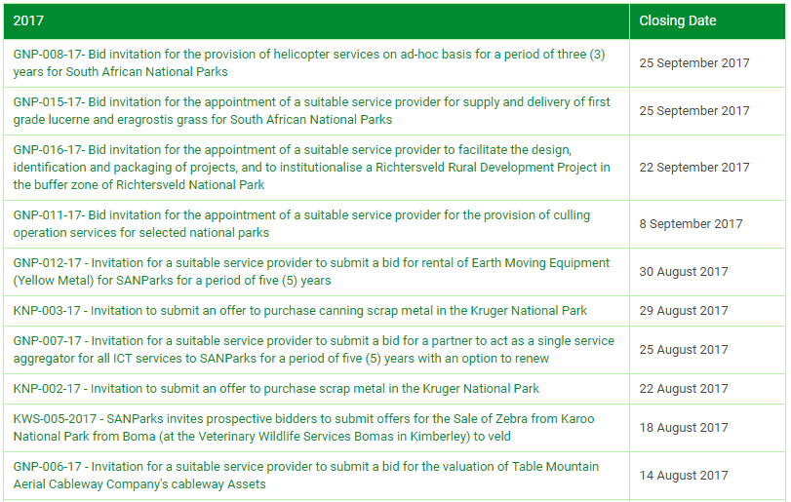
SCM + PPP’s
Notes:
In 1999 SANParks performed an internal review of its operations which reflected that when benchmarked against similar private operations, SANParks had:
Limited market segmentation
Limited product differentiation
Lack of investment in tourism plant
All of which has resulted in a high opportunity cost to biodiversity conservation
In addition:
Since 1994 the SA Government has been accountable to a broader electorate. Government’s limited resources are being reallocated amongst competing needs with a bias towards the more immediate social needs of the electorate. Although Government recognises its responsibility to conservation, funding allocations are based on affordability and conservation is no longer enjoying the levels of financial support it has grown used to.
SANParks, like most other conservation agencies is having to adapt to declining state subsidies. SANParks faces a situation characterized by:
increasing demands from the electorate for meaningful benefits;
Coupled with an urgent need to expand the national park system; and
declining financial resources available from the Government resulting in financial constraints of the organisation.

Slide 22
SCM + PPP’s
  Ample opportunities in tourism and National Parks
  Many earmarked for Level 1 and 2 BEE contributors
Notes:
In 1999 SANParks performed an internal review of its operations which reflected that when benchmarked against similar private operations, SANParks had:
Limited market segmentation
Limited product differentiation
Lack of investment in tourism plant
All of which has resulted in a high opportunity cost to biodiversity conservation
In addition:
Since 1994 the SA Government has been accountable to a broader electorate. Government’s limited resources are being reallocated amongst competing needs with a bias towards the more immediate social needs of the electorate. Although Government recognises its responsibility to conservation, funding allocations are based on affordability and conservation is no longer enjoying the levels of financial support it has grown used to.
SANParks, like most other conservation agencies is having to adapt to declining state subsidies. SANParks faces a situation characterized by:
increasing demands from the electorate for meaningful benefits;
Coupled with an urgent need to expand the national park system; and
declining financial resources available from the Government resulting in financial constraints of the organisation.

Slide 23
THANK YOU

Slide 24
  James Daniels
  Project Manager: Business Development Unit
  South African National Parks
  Tel: +27 12 426 5280
  E-mail: james.daniels@sanparks.org
  P O Box 787, Pretoria, 0001
  643 Leyds Street, Muckleneuk, Pretoria, 0002
  Website: http://www.sanparks.org

