Slide 1
TOURISM TRANSFORMATION SUMMIT
PUBLIC PRIVATE PARTNERSHIP TOOLKIT FOR TOURISM
^{PRESENTED BY:}
^{LINDOKUHLE HLATSHWAYO}
^{Senior Project Advisor}
^{31 October 2017}

Slide 2
Contents
Background of the Toolkit
2. Clarifying Key Policy issues for tourism PPPs
3. Suggested Business Model
4. Discussion: Questions and Answers

Slide 3
1. BACKGROUND
Process that began in 2004 and culminated in 2005 with a series of consultative workshops
Stakeholders in the tourism industry were involved –
conservation institutions around the country, private sector, NGO’s, DEAT and other government departments
The PPP manual and standardized provisions could not be summarily used to tourism PPP projects
Intention is to boost this sector of the economy and make it easier for institutions and the private sector to enter into tourism – related partnerships on state property managed by National and Provincial government institutions.

Slide 4
2. COMMUNAL AND PRIVATE LAND
The definition of a PPP in Treasury Regulation 16 specifies, inter alia, that a PPP involves the commercial use of state property.
where:
  The private/communal land form part of a protected area managed by the institution,
  The institution has statutory rights or obligations to provide tourism amenities and /or to commercially develop the protected area and,
  The institution have a contractual right from the owner to commercially develop the area.

Slide 5
CONTINUE;
Then it is a PPP by the virtue of the private party performing an institutional function.
In that scenario it is recommended that an institution apply to the relevant treasury for an exemption from Treasury Regulation 16 and allow the terms of co-management agreement to take precedence
The co-management agreement should, nevertheless attempt to follow best practice set by the Toolkit, as applicable.

Slide 6
CO-MANAGEMENT AGREEMENT?
No template – left to the institution and the community to decide
Could be concluded on four critical points
  The quality and quantum of conservation management to be provided by the conservation manager, the costs involved, and how failure to perform to agreed standards will be handled
  How the revenues and the costs from tourism or other uses of the land are to be shared between the landowner and the conservation manager
  How the necessary feasibility studies for, procurement and management of contractual relationships with third party private sector investors and operators will be collaboratively handled in support of both parties’ rights and obligations

Slide 7
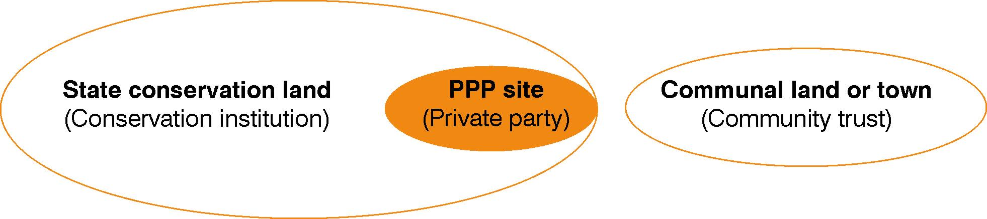
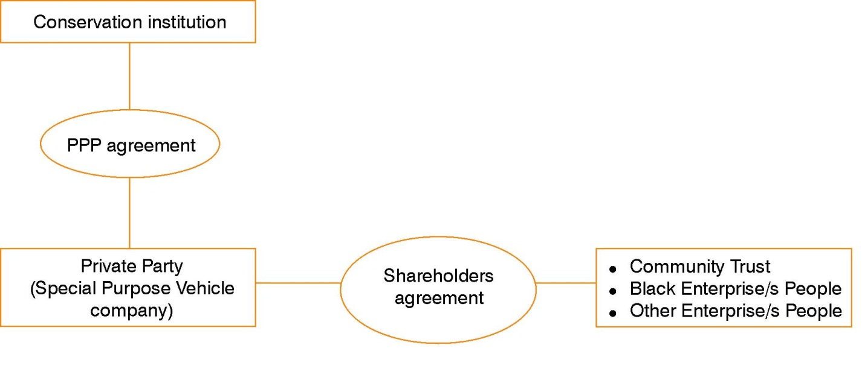
BBBEE AND COMMUNITY IN PPP

Slide 8
COMMUNAL AND PRIVATE LAND
Treasury Regulation 16: PPP typically involves the commercial use of state property
But sometimes, institution performs institutional functions through co-management agreements, on communal/private property which is protected.
In these cases, the Toolkit provides for:
- Co-management agreement back-to-back with a community–private party agreement
- Co-management agreement back-to-back with a community–public–private partnership agreement

Slide 9
COMMUNAL AND PRIVATE LAND

Slide 10
3. SUGGESTED BUSINESS MODEL
Setting up a Community trust;
  To protect communal asset
  Nominate Trustee
  Naming of beneficiaries
  Tax rate for trust is 40%
Registering a PTY LTD
  Trustees to be Directors of the company
  Trade as a business entity for commercial activities
  Lease development land from Trust
  Pay lease fee from
  Engage on CSI programmes as directed by shareholders.
  Tax rate is at 28%

Slide 11
4. CONCLUSION
Questions and Discussions

Slide 12
Thank you
PPP Unit
GTAC
240 Madiba Street
Tel: +27 12 315 5525
Fax:+27 12 315 5477
www.gtac.gov.za

